Slide 1





ORBIDO
2025
OPUS
SLOP
DETECTOR
AI CONTENT, MANIPULATION & MISINFORMATION AUDIT WORKFLOW

Slide 2






!
Content arrives in many formats → text, images, PDFs, social posts, reels
WHAT IS THE PROBLEM?
Detection requires both rules + reasoning.
THE SPREAD OF MISINFORMATION
High volume → slow & expensive.
No audit trail → zero transparency for decisions

Slide 3

OUR
SOLUTION
01
DETECTS AI GENERATED CONTENT
02
FLAGS MISINFORMATION
03
We built a reusable automation that:
GENERATES A FULL AUDIT REPORT
04
INDETIFIES IMAGE MANIPULATION
05
ROUTES BORDERLINE CASES TO HUMAN REVIEW

Slide 4







OPUS
DESIGNED AS A PLUGIN OR EXTENSION FOR:
BROWSERS AND NEWS ARTICLES
ANY HIGH-VOLUME SOCIAL CONTENT STREAM
INSTAGRAM REELS AND TIK TOK VIDEOS

Slide 5
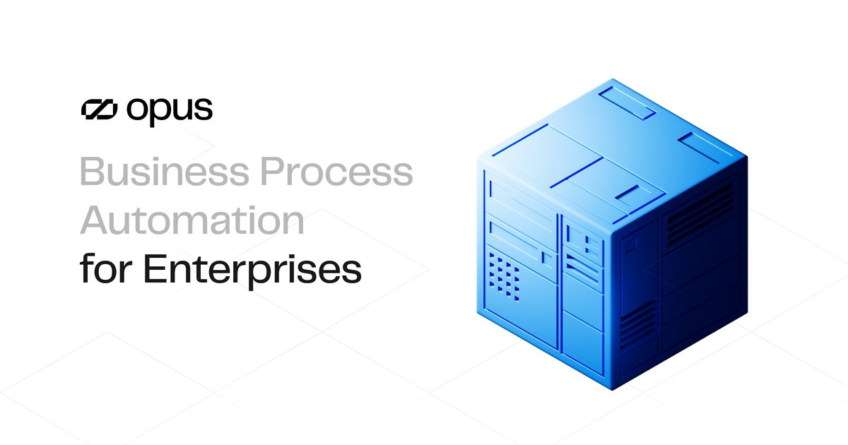
WHY OPUS?
Structured Fact-Checking
Clear Routing Logic
Full Traceability
Human-in-Loop Support
Easy Workflow Building

Slide 6

INTAKE
UNDERSTAND
DESIGN
REVIEW
DELIVER

Slide 7
INTAKE LAYER UNDERSTANDING LAYER
Accepts 5 different inputs.
Parallel processing ensures fast analysis, supporting high-volume feeds like 100+ social posts at once.
METADATA
We run specialized agents:
AI likelihood detection
Linguistic anomaly detection
Image manipulation/AI detection
Claim extraction & fact preparation
Metadata checks & pattern validation
PDFs
Images
Text
JSON
API data from public sources
OCR
API

Slide 8



TWO LAYERS:
DETERMINISTIC RULES
text length
OCR quality
metadata missing
misinformation signals
manipulation risk
AI score thresholds
2. AI SCORING ENGINE
AI likelihood
misinfo risk
virality
metadata penalty
manipulation likelihood
DECISION LAYER
REVIEW LAYER
01
AGENTIC REVIEW:
Enforces policy
Overrides unsafe output
Confirms inconsistencies
HUMAN REVIEW
Triggered when:
.
Low confidence
Borderline score
Contradictory signals
Missing metadata
THIS KEEPS A HUMAN IN THE LOOP, REQUIRED FOR RESPONSIBLE AI.

Slide 9





DELIVERY STAGE
FINAL RESULT
AI EXPLANATION
02
MODEL DECISIONS
REVIEW ACTIONS
FINAL DECISIONS
04
TRUE
FALSE
NEEDS REVIEW.
FLAGS+REASONS
EXPORT OPTIONS
01
03
JSON
PDF
EXCEL SHEETS
CLEAR EXPLANATIONS
FOR
FLAGGED CONTENT.

Slide 10
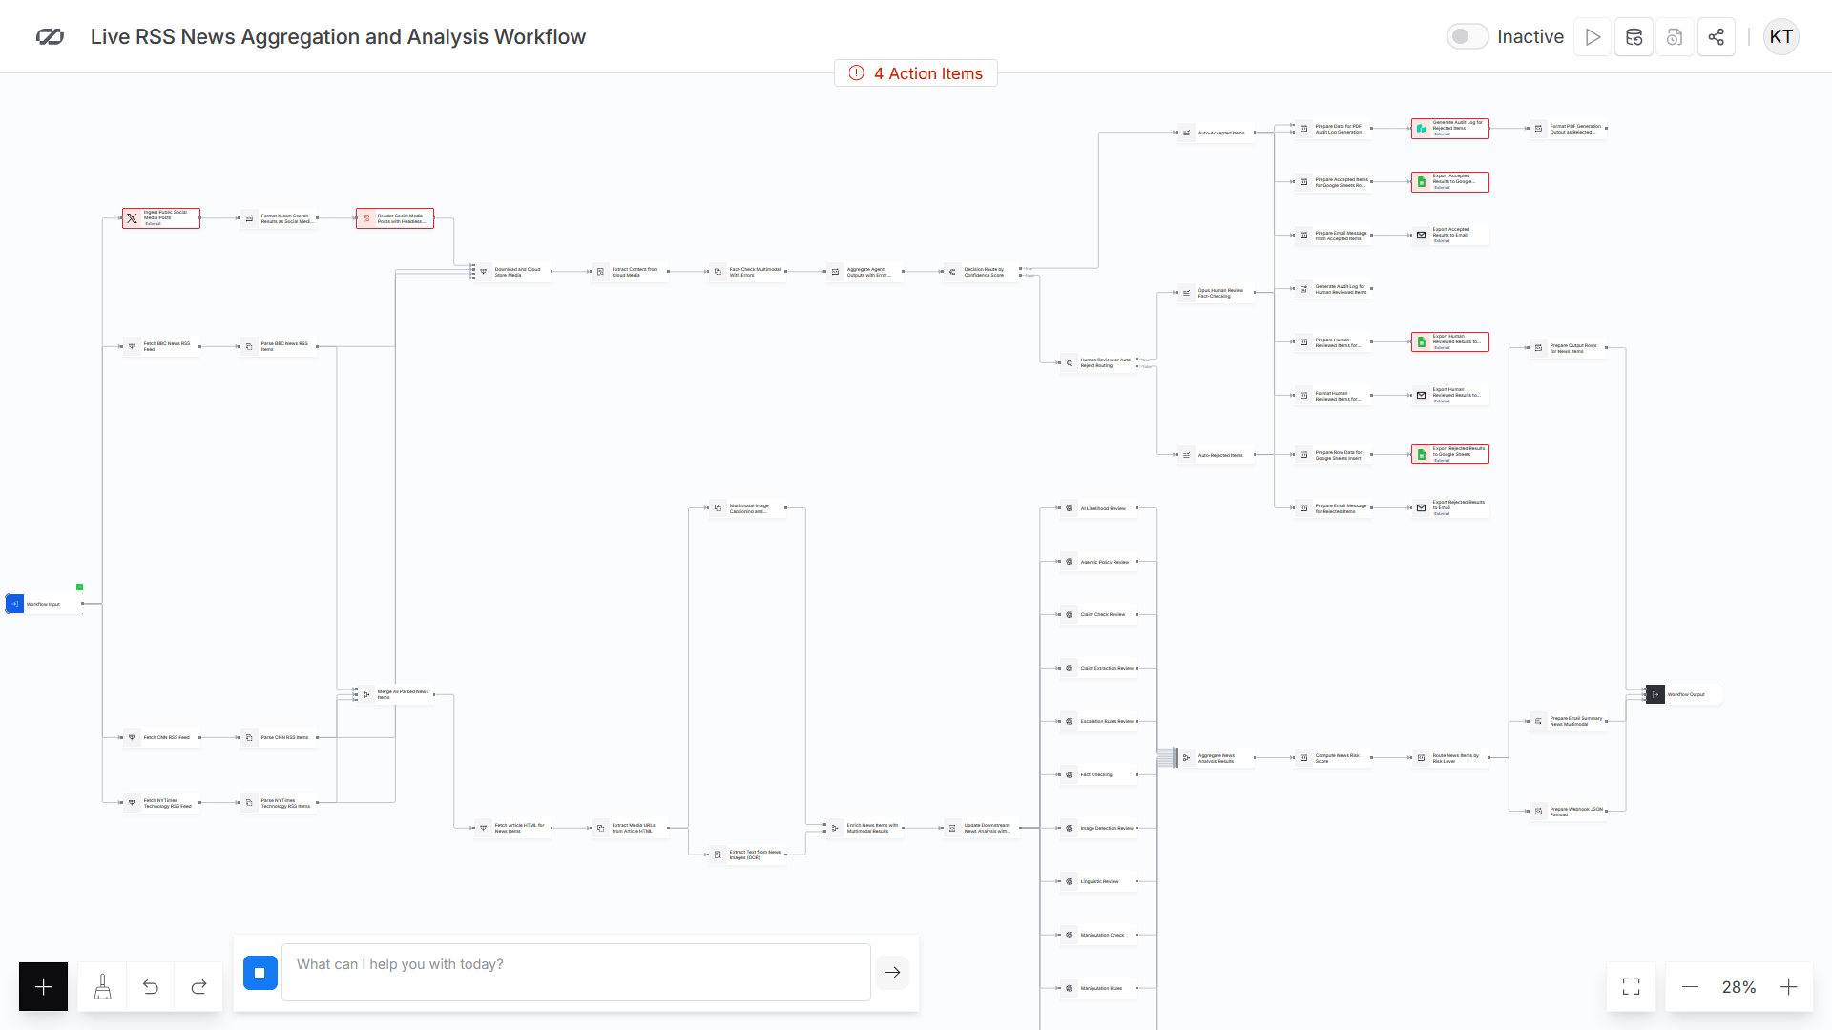

Slide 11



OUR SYSTEM IS INDUSTRY-AGNOSTIC AND REUSABLE
USE CASES
NEWS AND MEDIA
INSTAGRAM/TIK TOK
CORPORATE
CHECKS:
false claims
AI-written articles
image tampering
metadata inconsistencies
Detect AI-generated reels
face swaps
synthetic voices
AI-written captions
manipulated images
Fake invoices
Fabricated documents
Fake employee IDs

Slide 12


PRODUCT VISION
A FULL MODERATION PLUGIN/EXTENSION THAT CAN BE EMBEDDED INTO:
BROWSER EXTENSION FOR INSTAGRAM / TIKTOK INSPECTION
NEWSROOM CMS
SOCIAL MEDIA COMMAND CENTERS
INTERNAL CORPORATE REVIEW TOOLS
User uploads or pastes a URL →
Plugin triggers Opus API →
Receives structured analysis + audit trail.

Slide 13


MEET OUR TEAM
KLEA TOMORRI
Muhammad
Hammad Khilji
AI Reasoning & Policy
Engineer
Review Intelligence & Audit
Lead
HAREM HARSHAD
Naila Sadia
Flow Architect & System
Orchestrator
Experience & Delivery
Enginee.

Slide 14



LINKS:
OPUS WORKFLOW LINK

